Slide 1
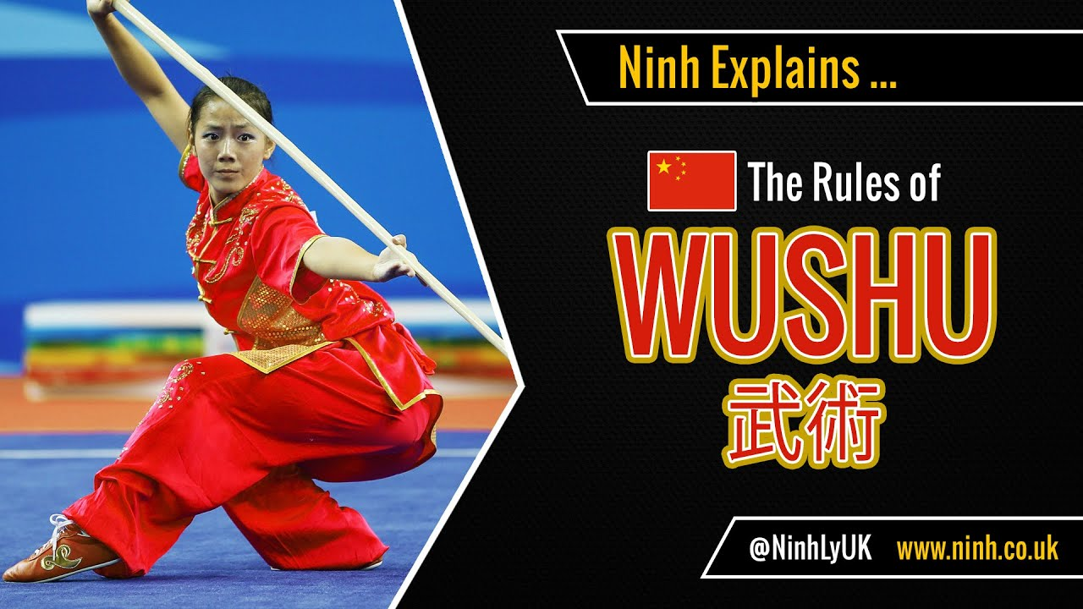
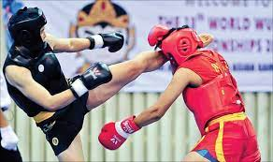
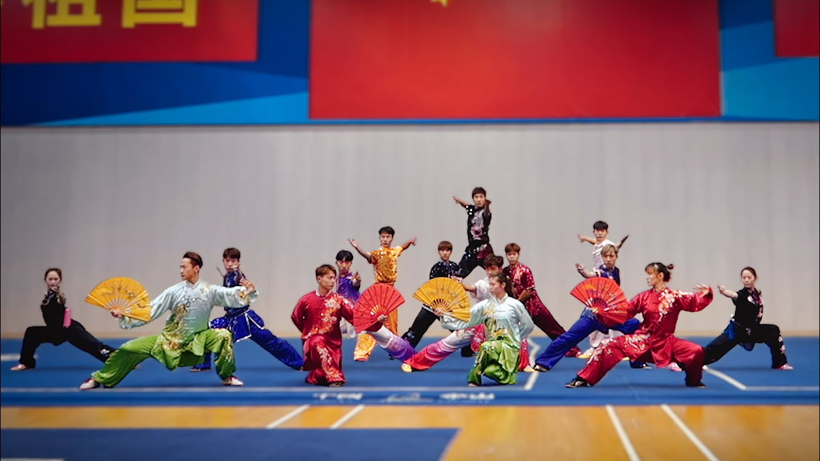
WUSHU

Slide 2
What is WUSHU
The sport of wushu is both an exhibition and a full-contact sport derived from traditional Chinese martial arts. It was created in the People’s Republic of China after 1949, in an attempt to nationalize the practice of traditional Chinese martial arts. Most of the modern competition forms were formed from their parent arts by government-appointed committees. In contemporary times, wushu has become an international sport through the International Wushu Federation (IWUF), which holds the World Wushu Championships every two years.
Competitive wushu is composed of two disciplines: taolu (forms) and sanda (sparring). Taolu involve martial art patterns and maneuvers for which competitors are judged and given points according to specific rules. The forms comprise basic movements (stances, kicks, punches, balances, jumps, sweeps and throws) based on aggregate categories of traditional Chinese martial art styles and can be changed for competitions to highlight one’s strengths. Competitive forms have time limits that can range from 1 minute, 20 seconds for some external styles to over five minutes for internal styles. Modern wushu competitors are increasingly training in aerial techniques such as 540 and 720 degree jumps and kicks to add more difficulty and style to their forms.
Wushu can be seen in almost all action movies today, promoted by the likes of Jet Li, Donnie Yen, and Chow Yun Fat, amongst others.
On January 8, 2020, Wushu was included in the official competition of the Fourth Youth Olympic Games.

Slide 3
History of WUSHU
In 1958, the government established the umbrella organization to regulate martial arts training. The Chinese State Commission for Physical Culture and Sports took the lead in creating standardized forms for most of the major arts. During this period, a national Wushu system that included standard forms, teaching curriculum, and instructor grading was established. Wushu was introduced at both the high school and university level. This new system seeks to incorporate common elements from all styles and forms as well as the general ideas associated with Chinese martial arts. Stylistic concepts such as hard, soft, internal, external, as well as classifications based on schools such as Shaolin, Taiji, Wudang and others were all integrated into one system. Wushu became the government sponsored standard for the training in martial arts in China. The push for standardization continued leading to widespread adaptation.
In 1979, the State Commission for Physical Culture and Sports created a special task force to teaching and practice of Wushu. In 1986, the Chinese National Research Institute of Wushu was established as the central authority for the research and administration of Wushu activities in China. Changing government policies and attitudes towards sports in general led to the closing of the State Sports Commission (the central sports authority) in 1998. This closure is viewed as an attempt to partially de-politicize organized sports and move Chinese sport policies towards a more market-driven approach. As a result of these changing sociological factors within China, both traditional styles and modern Wushu approaches are being promoted by the International Wushu Federation.

Slide 4
Type of Events in WUSHU
SANSHOU
Sanshou, Sanda, boxing, kickboxing, or an "unsanctioned fight" is a self-defense system and combat sport. Sanshou is a martial art which was originally developed by the military based upon the study and practices of traditional Kung fu and modern combat fighting techniques; it combines full-contact kickboxing, which includes close range and rapid successive punches and kicks, with wrestling, takedowns, throws, sweeps, kick catches, and in some competitions, even elbow and knee strikes.
TAOLU
According to the International Wushu Federation, “Wushu taolu is a set of connecting stylized movements choreographed according to certain laws, embodying the philosophical connotation of attack and defense.”
The taolu listed below are the compulsory routines for international Wushu competitions. According to Kung-Fu Wushu Western Australia, “International wushu competition is categorized by junior (18 and under) and senior (18 and over) level championships. In junior level events, the taolu routines are “compulsory” whereas each athlete performs identical movements and sequences that have been developed by the technical committee of the IWuF. Senior level events are competed using optional or “self choreographed” routines that can highlight the strengths of the individual athlete”.

Slide 5
Age Categories in WuSHU
1. Sub – Junior (Under 14 Years)
2. Junior (Above 14 to Below 16 Years)
3. Youth (Above 16 to Below 18 Years)
3. Senior (Above 18 to Below 40 Years)

Slide 6
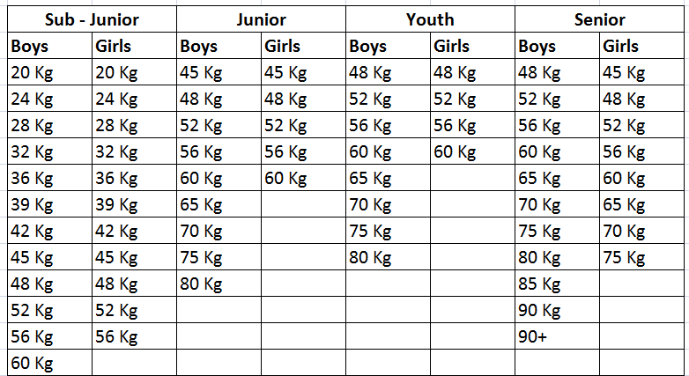
Weight Categories in SANSHOU

Slide 7
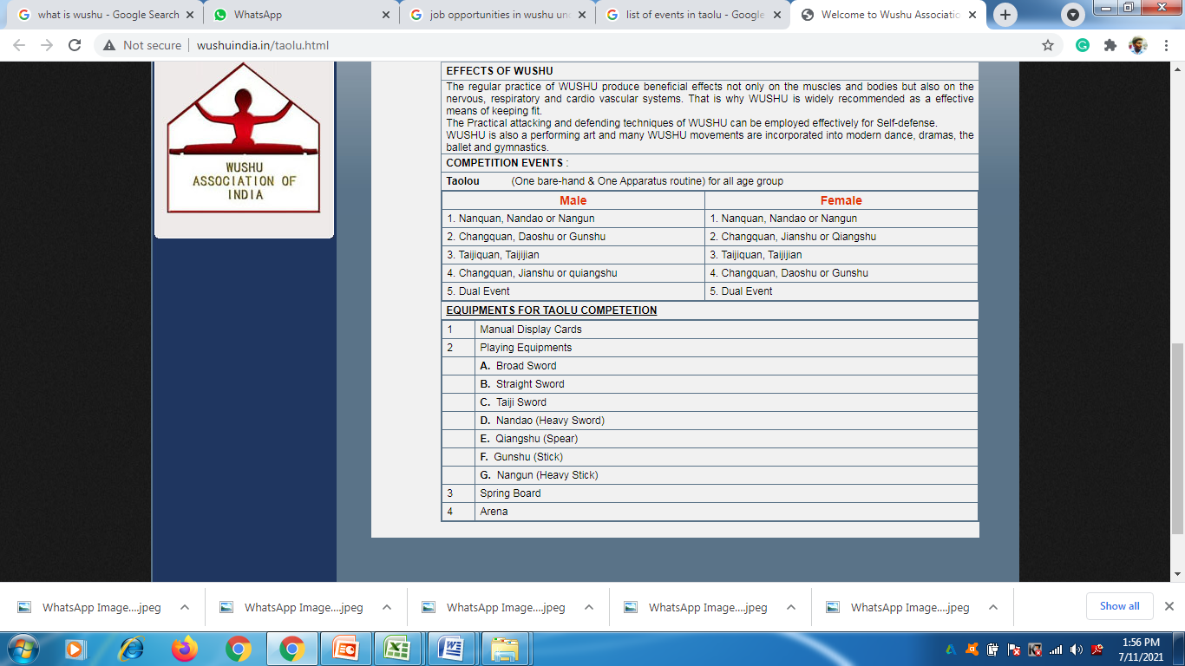
Events in TAOLU

Slide 8
Competitions in WUSHU
Major international and regional competitions featuring WUSHU include:
Olympic Games
Junior Olympic Games
World Wushu Championship
World Junior Wushu Championship
World Games
World Combat Games
Asian Games
South Asian Games
National Games of India
State Championships
District Championships

Slide 9
Government Job Opportunities in Wushu Sports
Indian Army
CRPF
BSF
Air Force
ITBP
Assam Rifles
SSCB
SSB
All India Police
SAI Coach
Under 3% Sports Quota by Tamilnadu Government

Slide 10
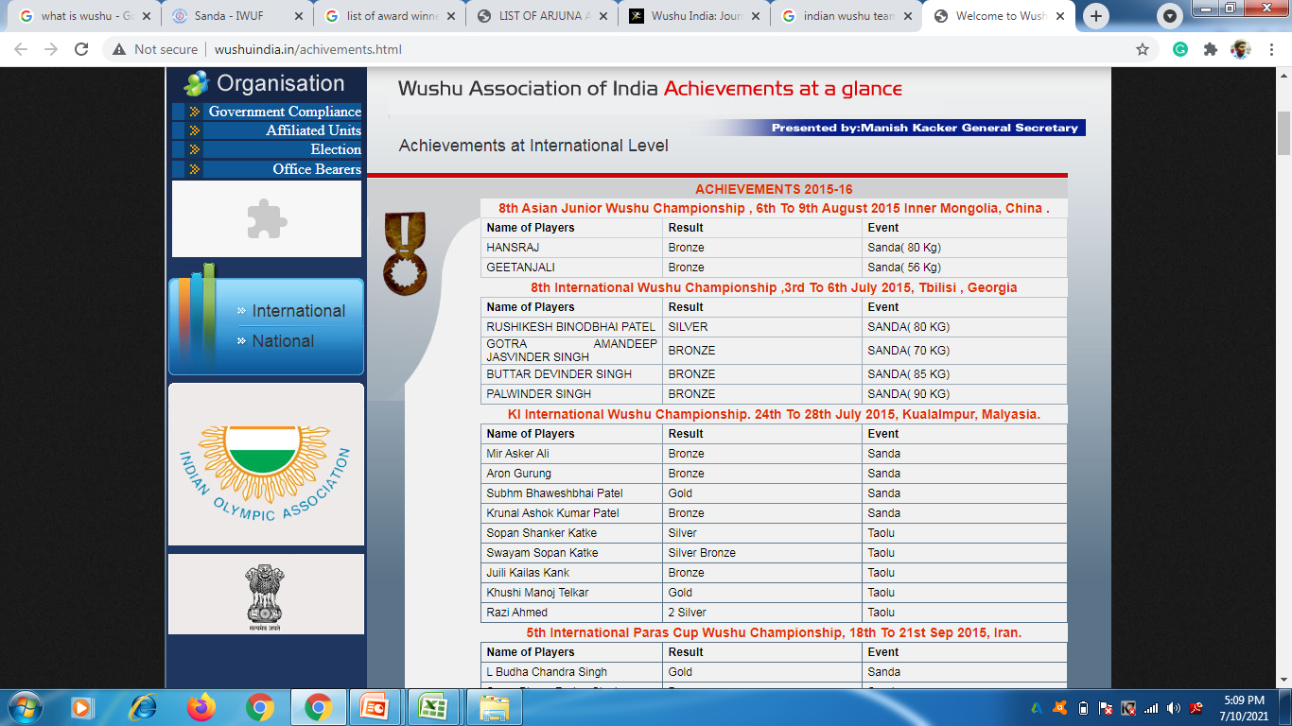
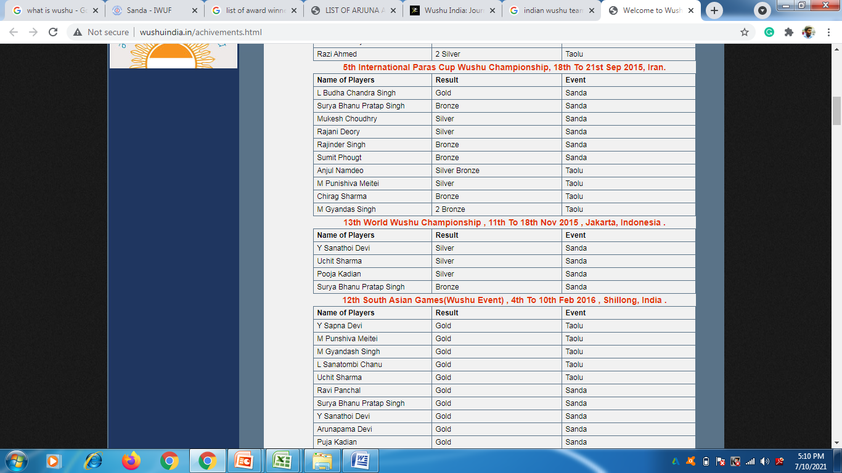
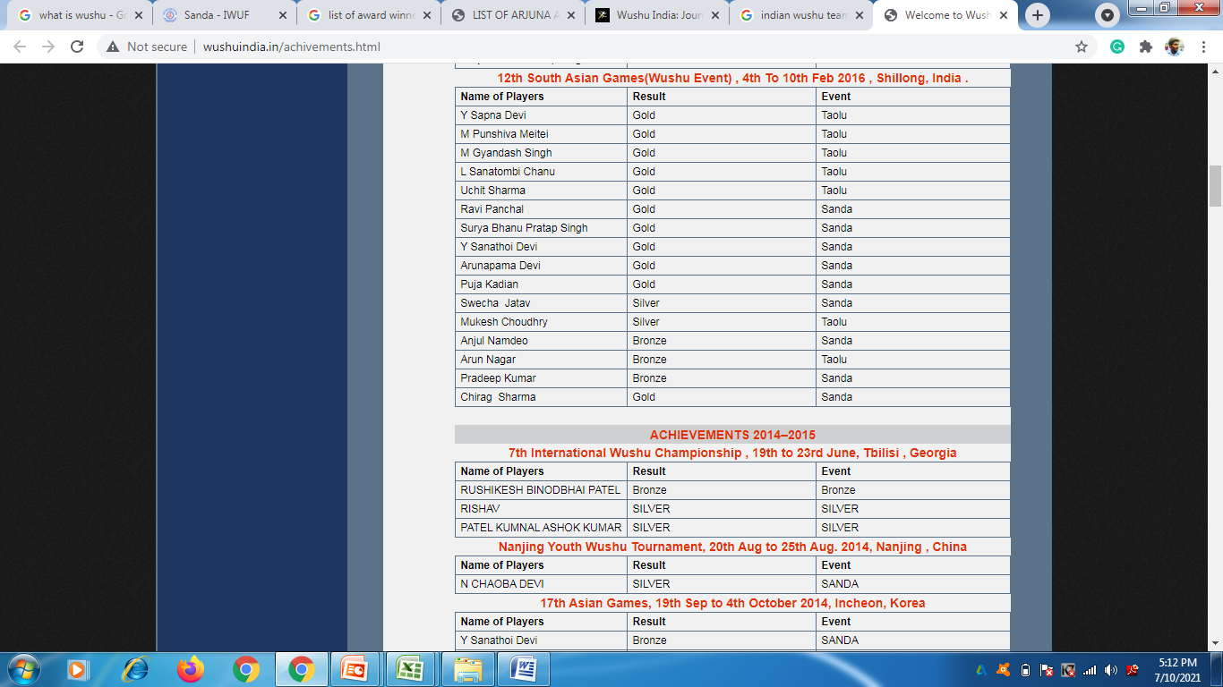
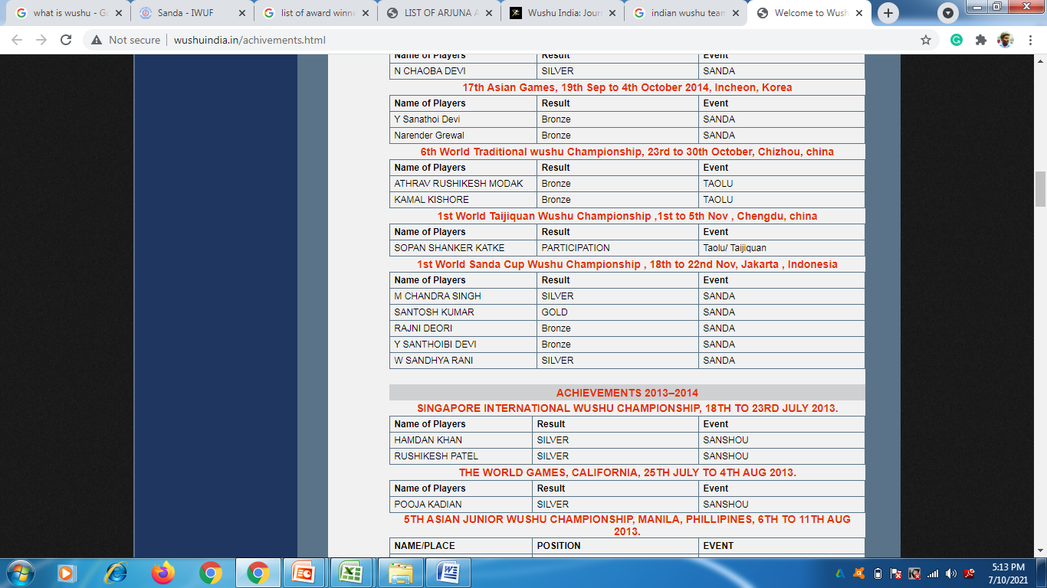
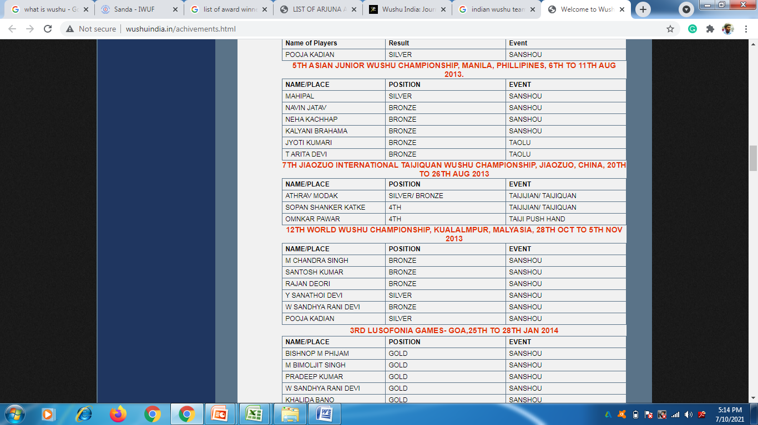

Indian Wushu Achievements in International Championships

Slide 11
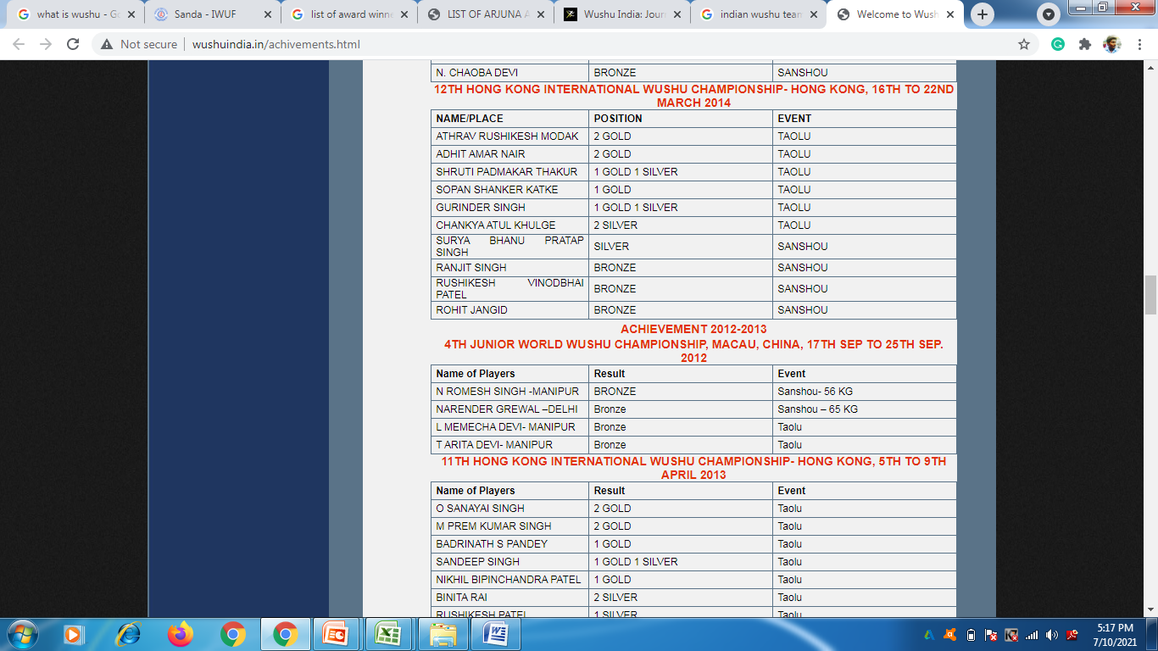
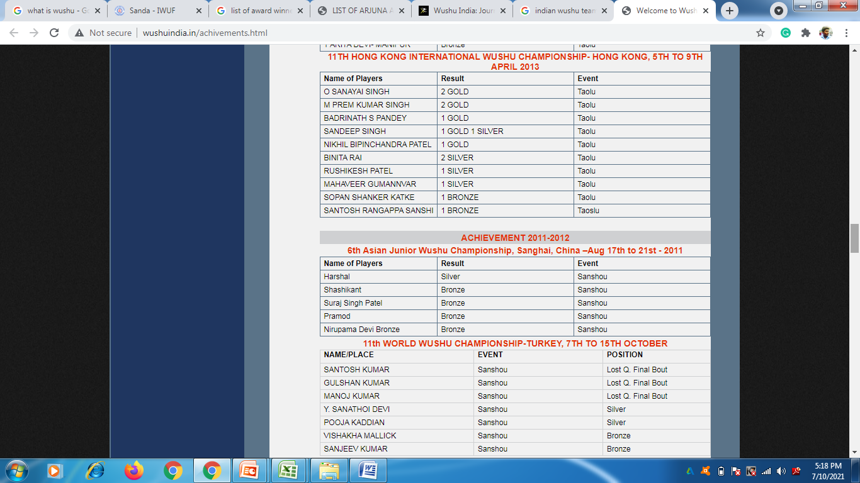
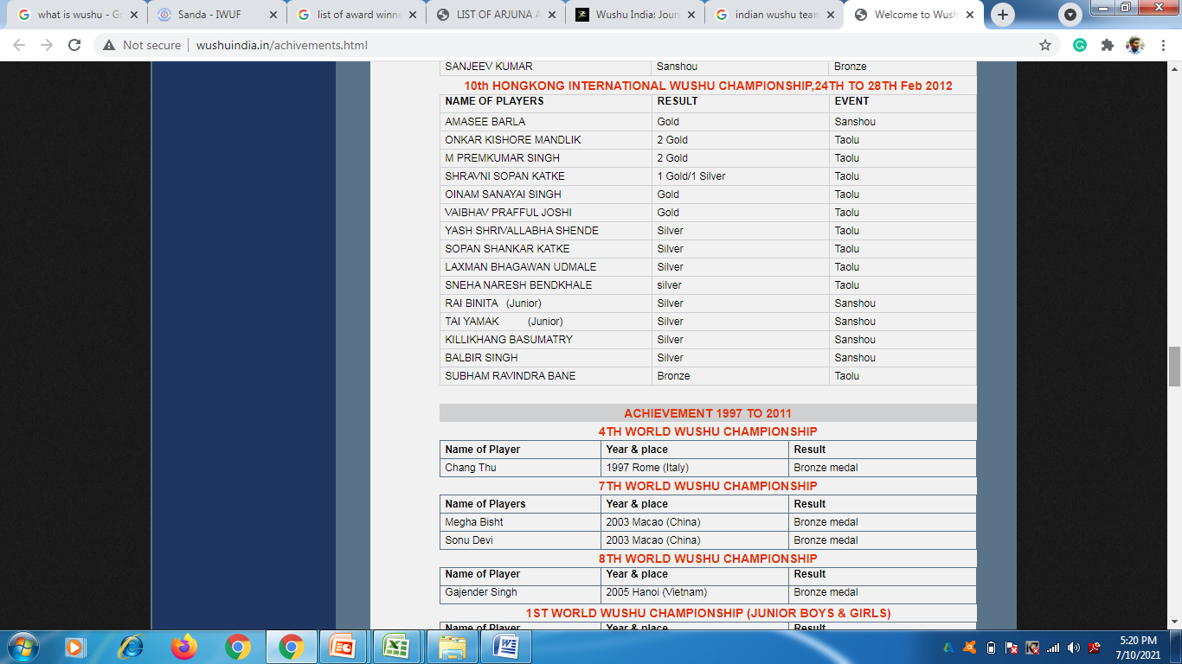
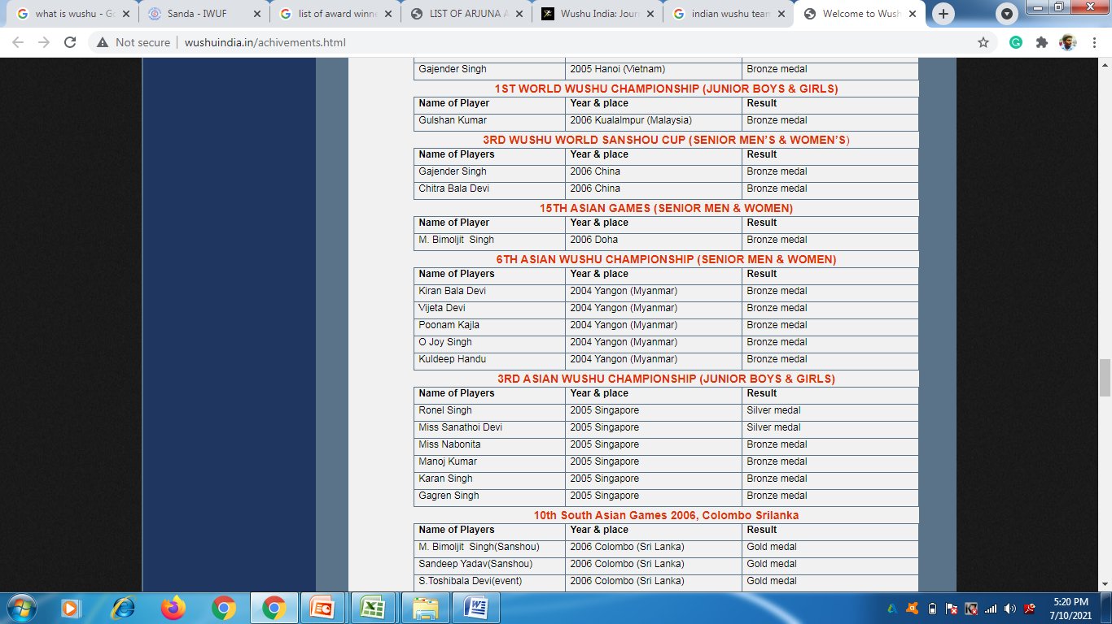
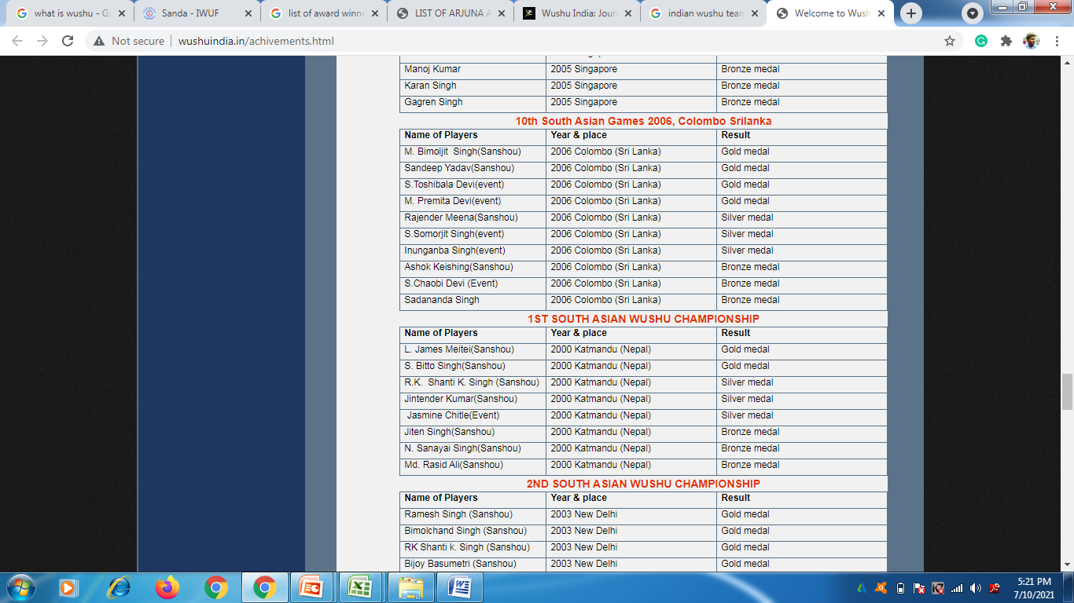
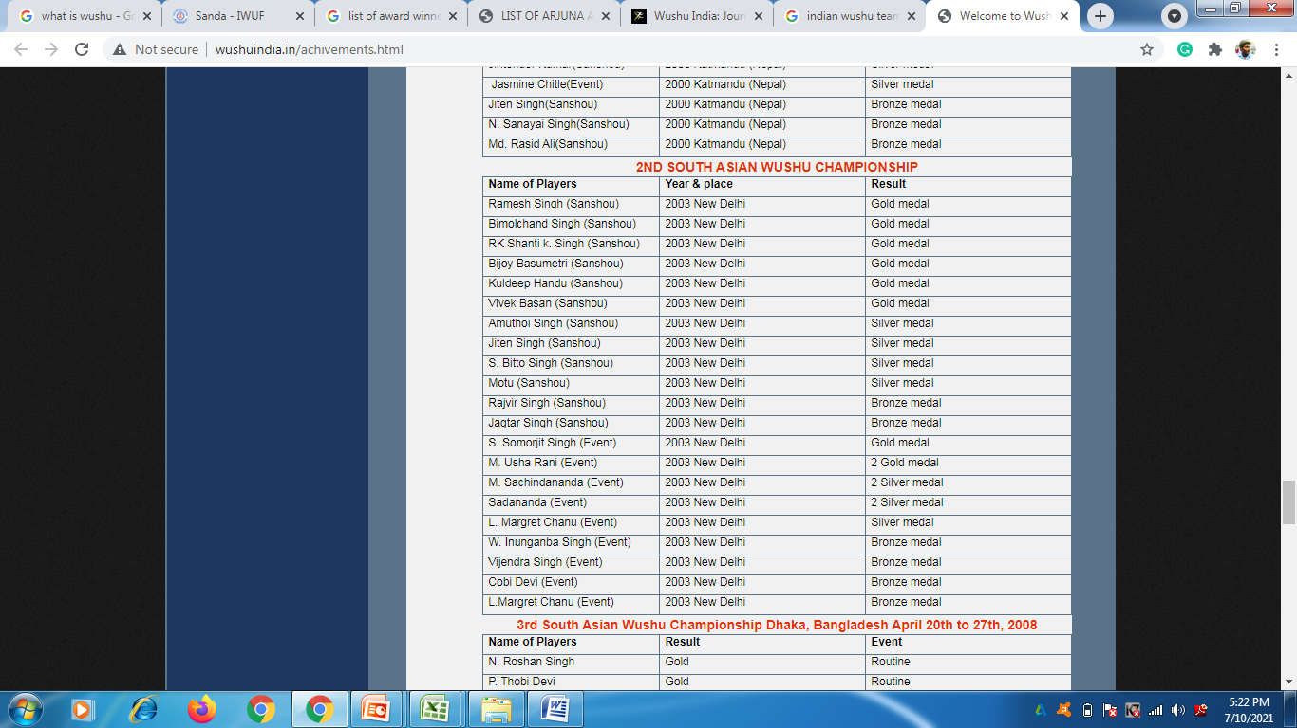
Indian Wushu Achievements in International Championships

Slide 12
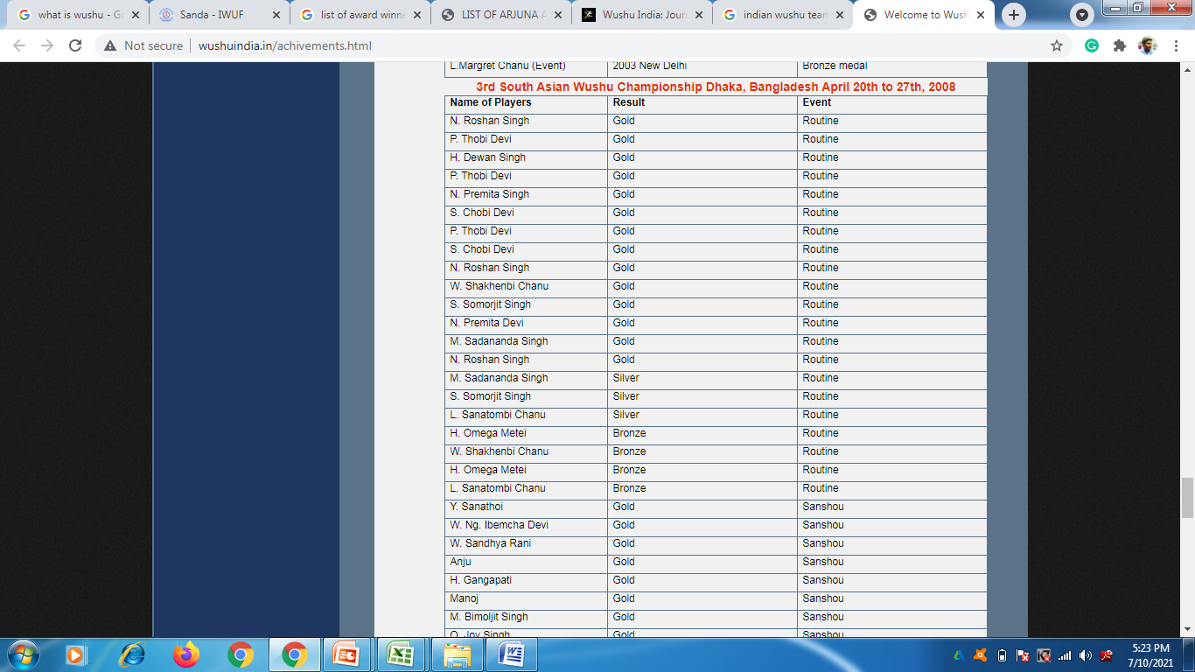
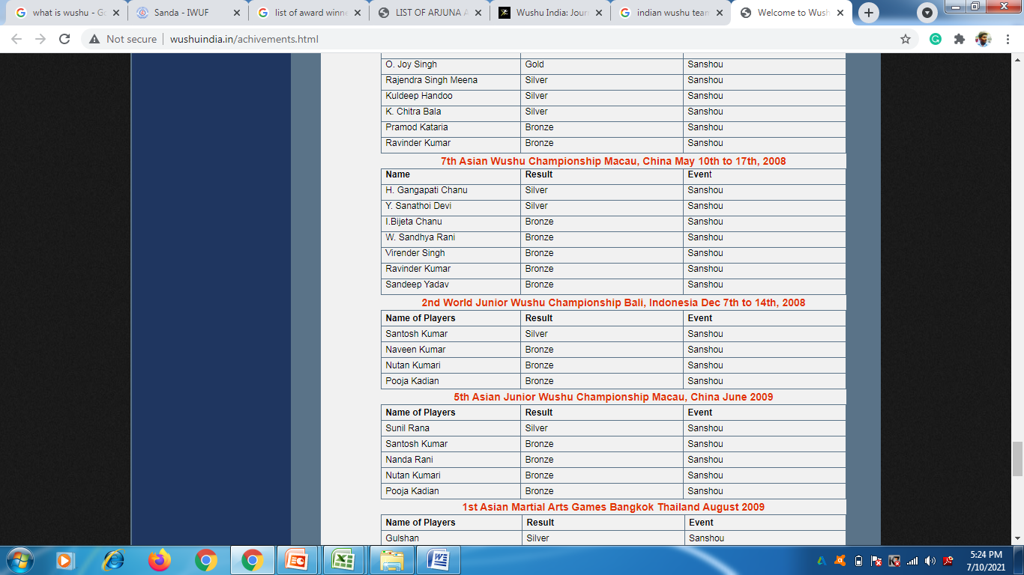
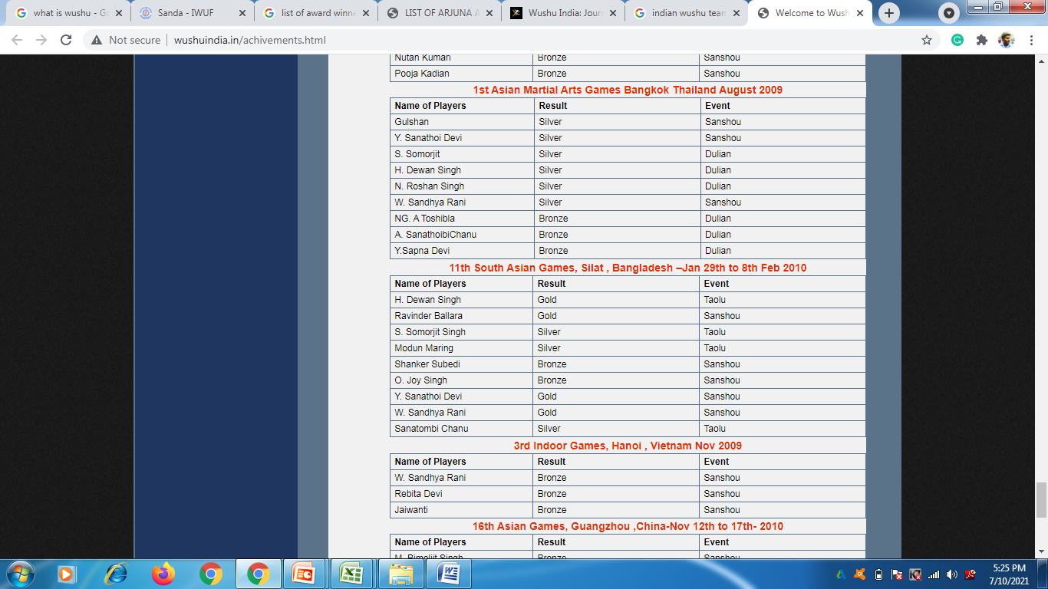
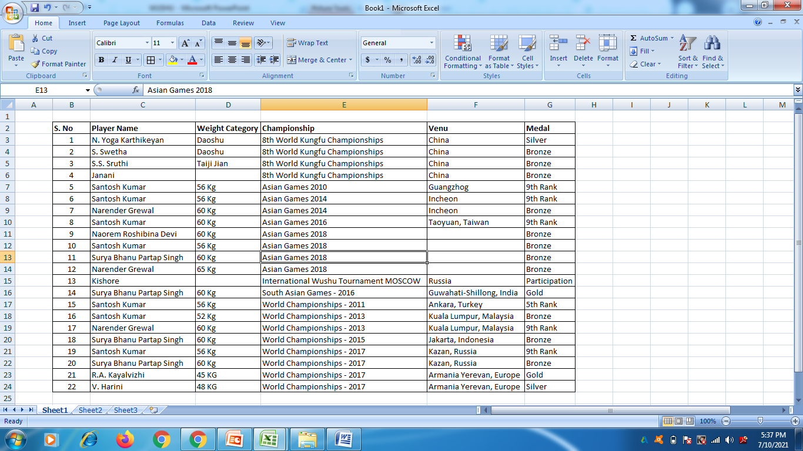
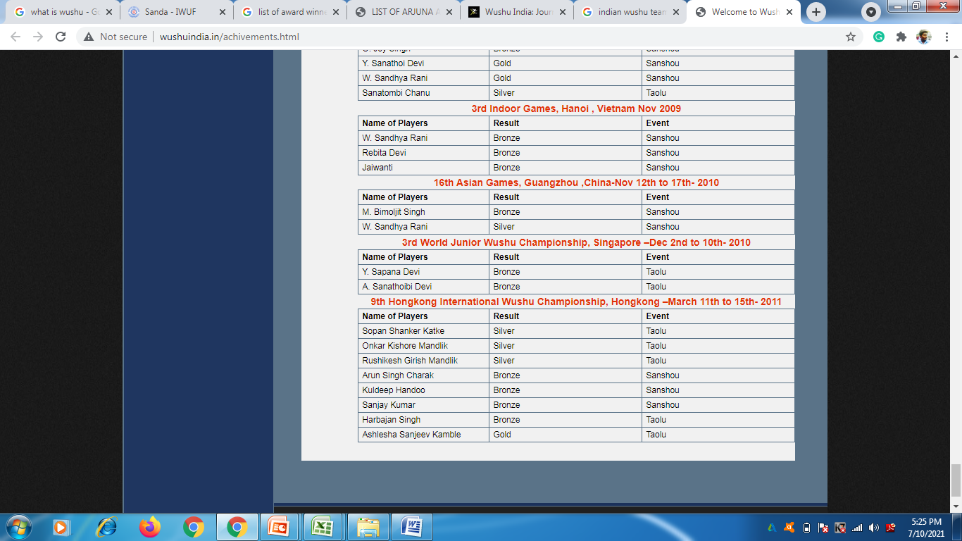
Indian Wushu Achievements in International Championships

Slide 13
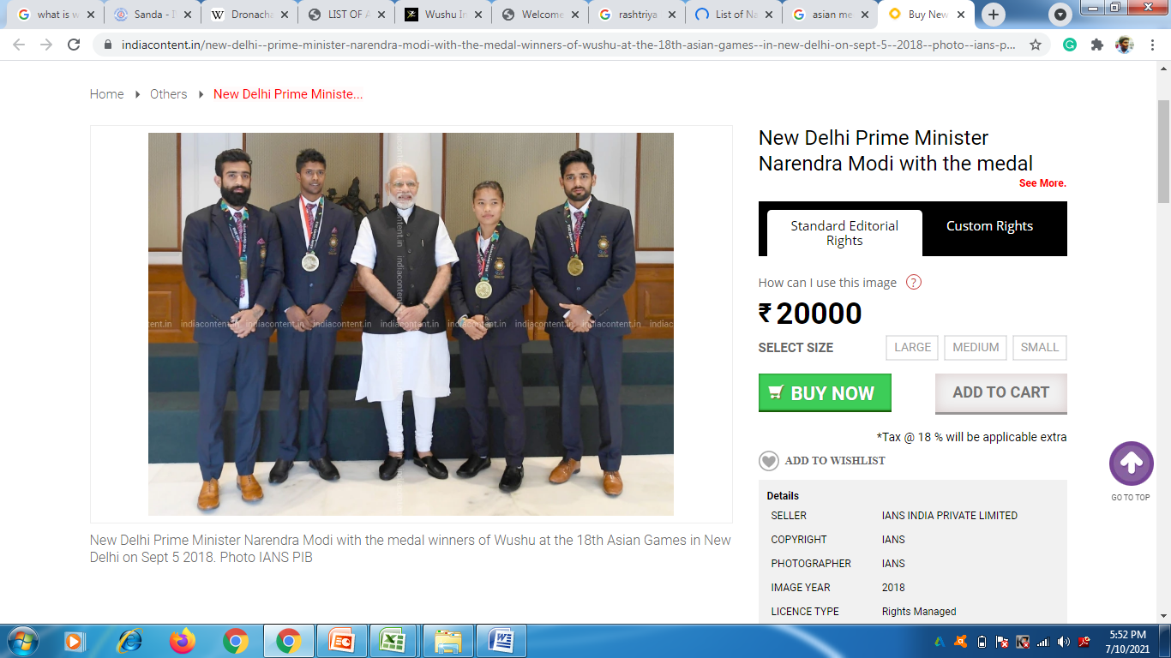
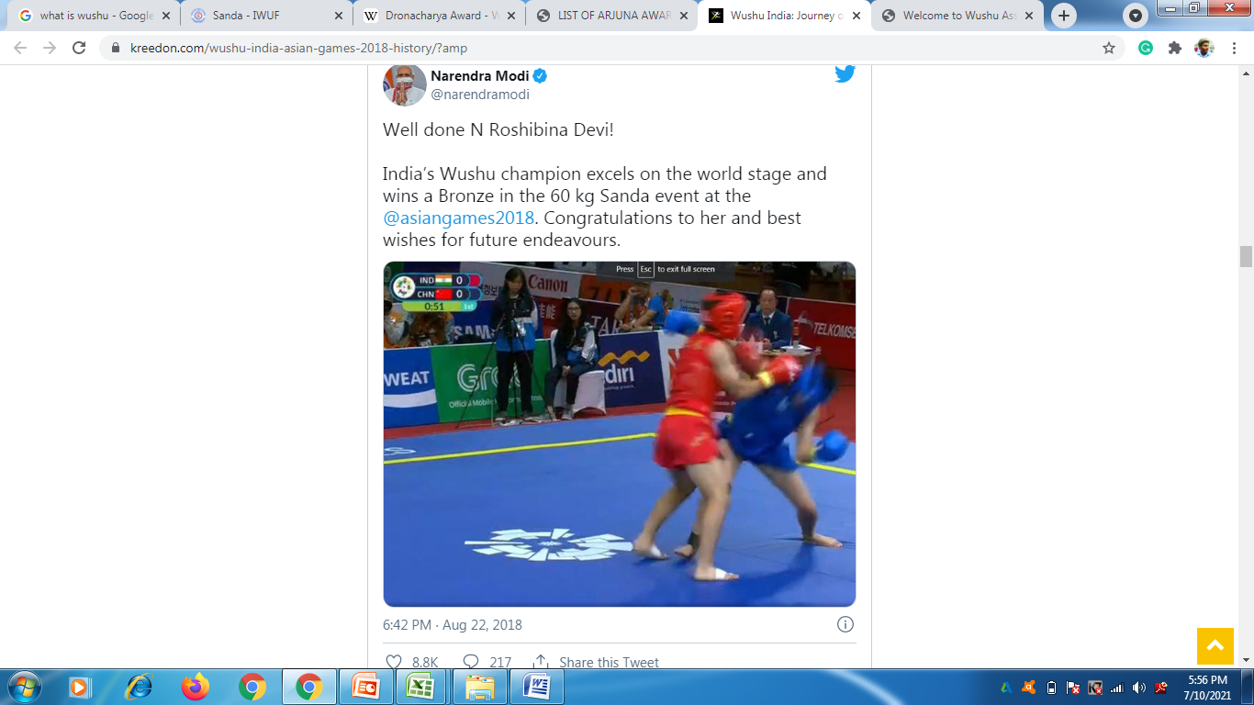
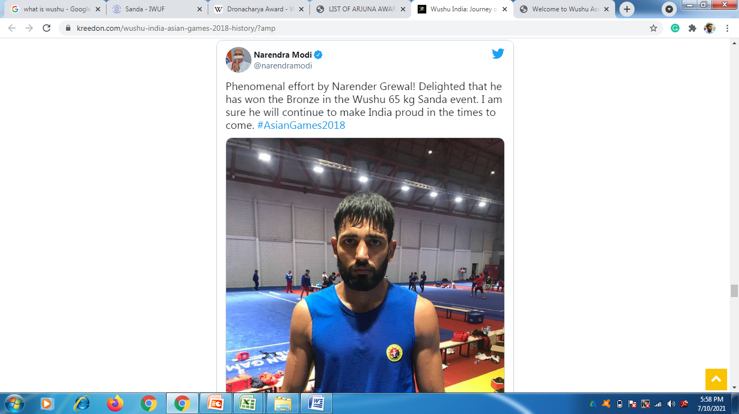
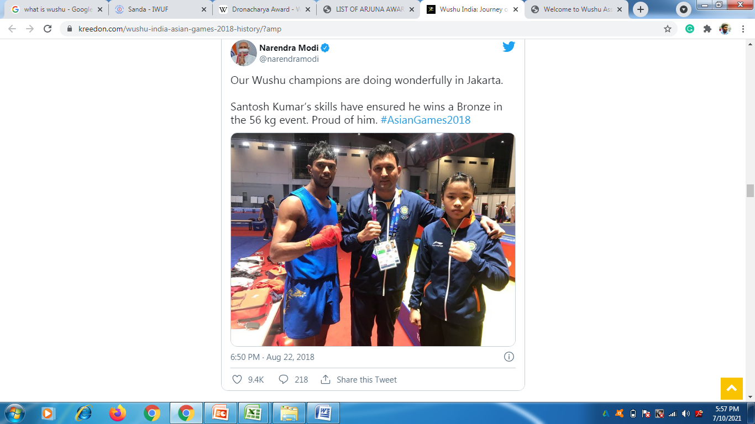
Indian Wushu Achievements in International Championships

Slide 14
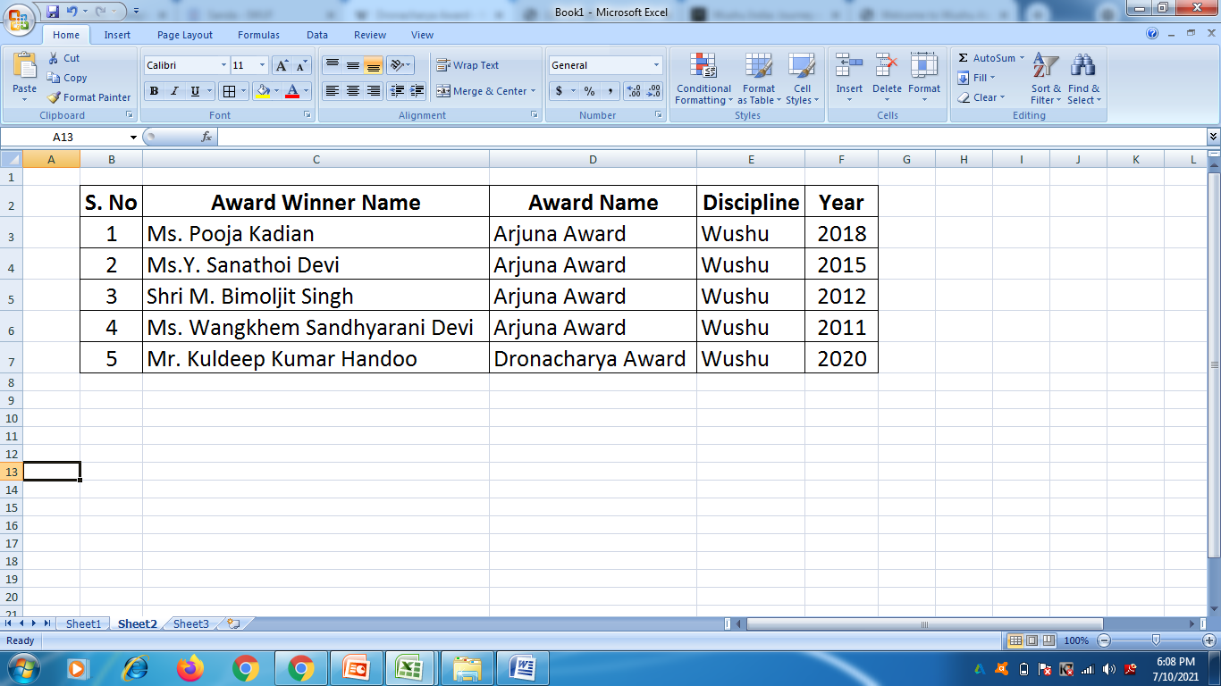
List of National Award Winners in WUSHU

Slide 15
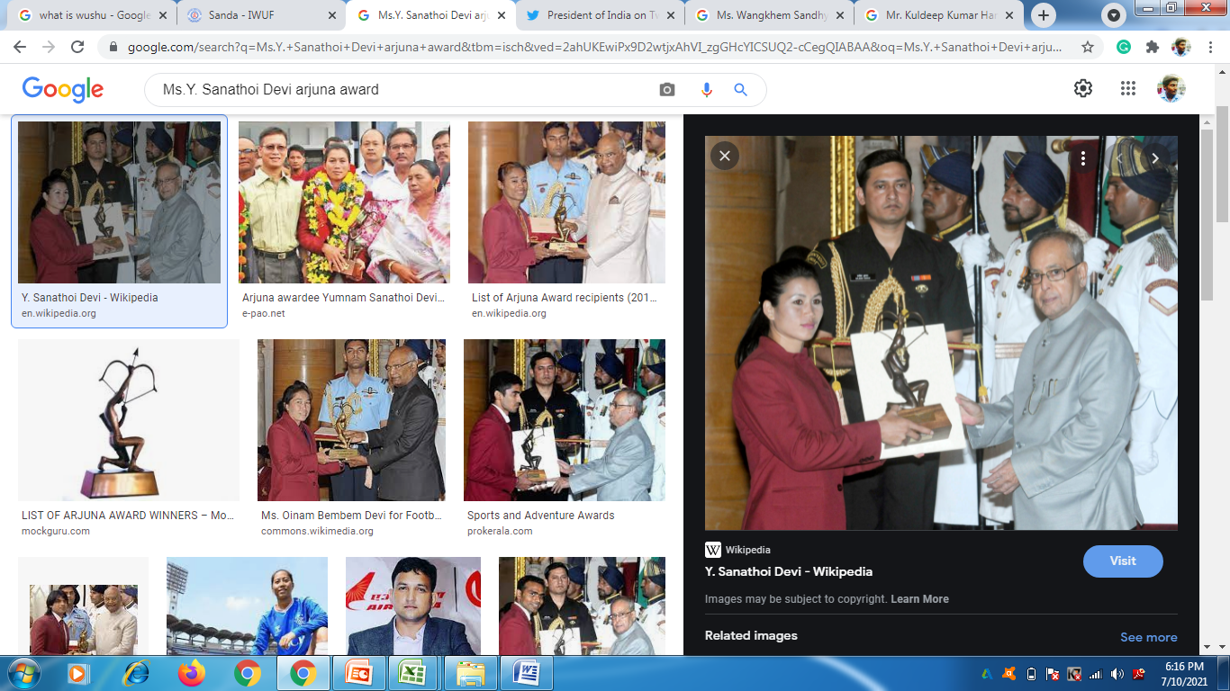
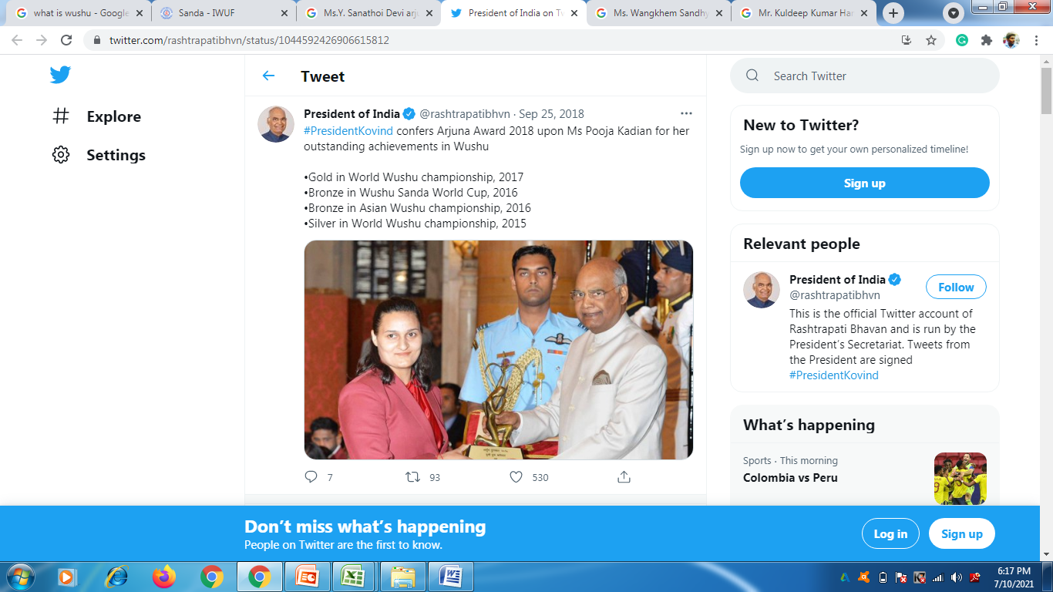
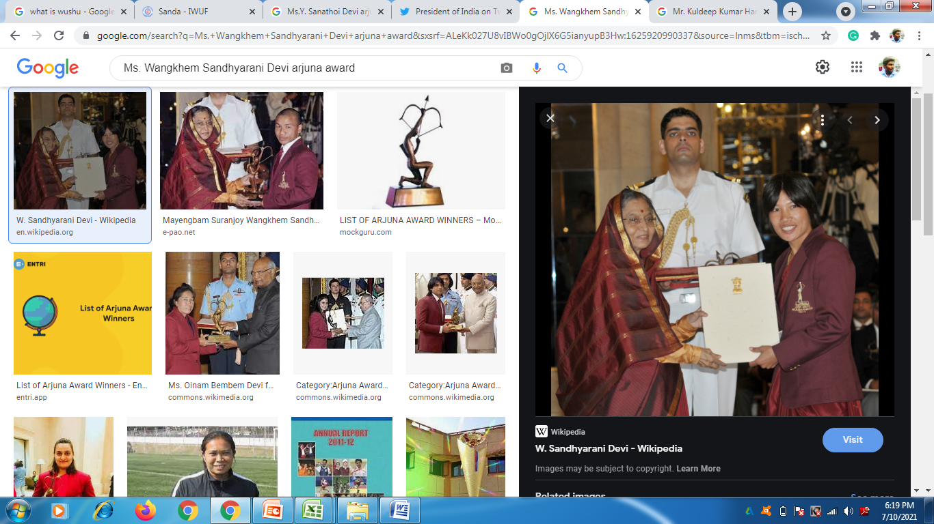
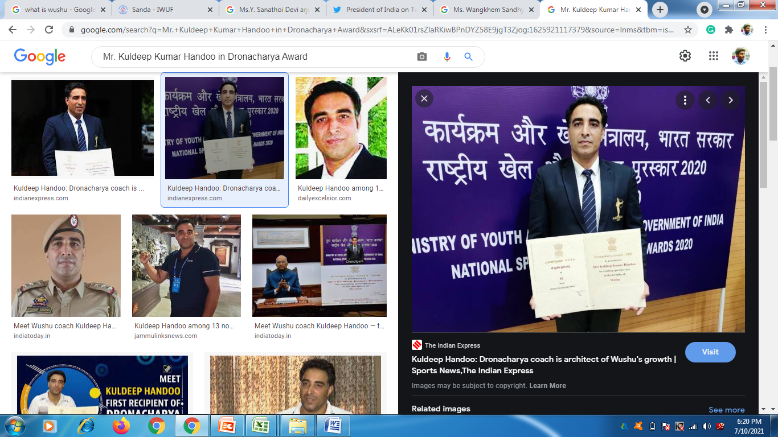
List of National Award Winners in WUSHU

Slide 16
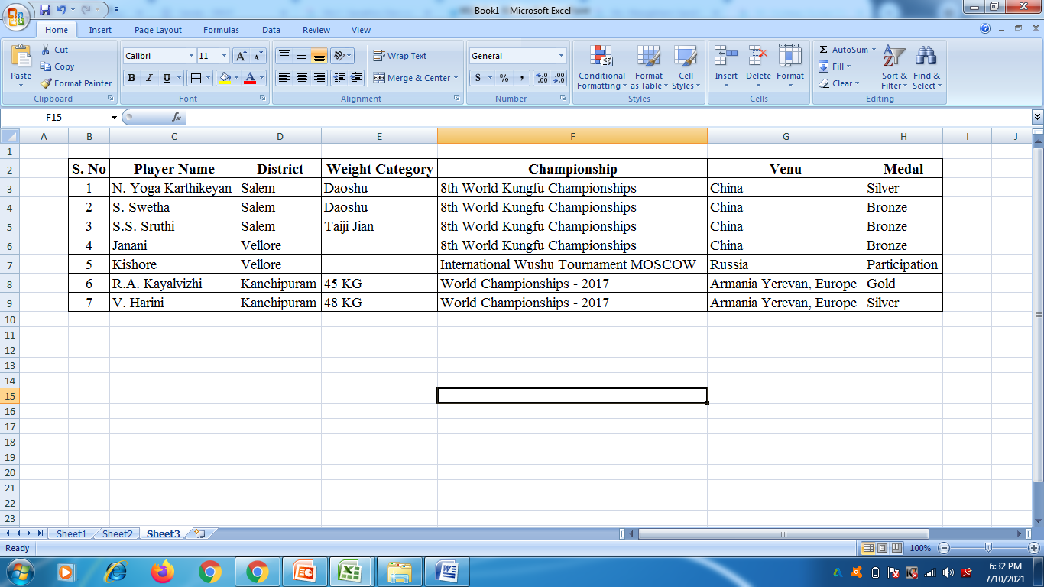
Tamil Nadu WUSHU Achievements in International Championships

Slide 17
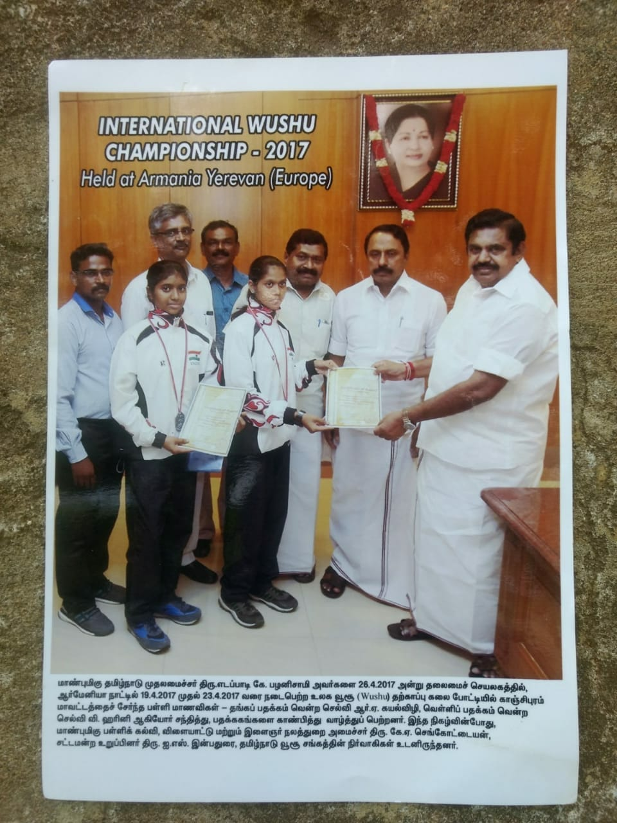
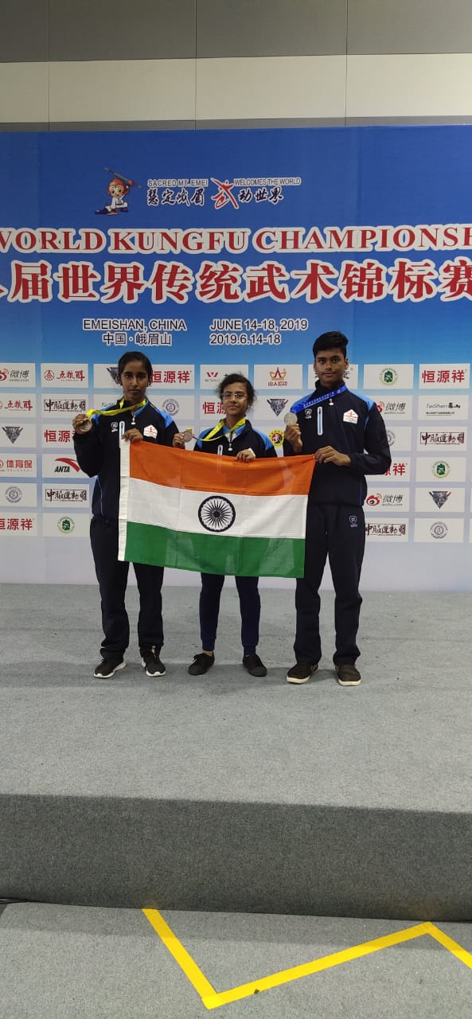
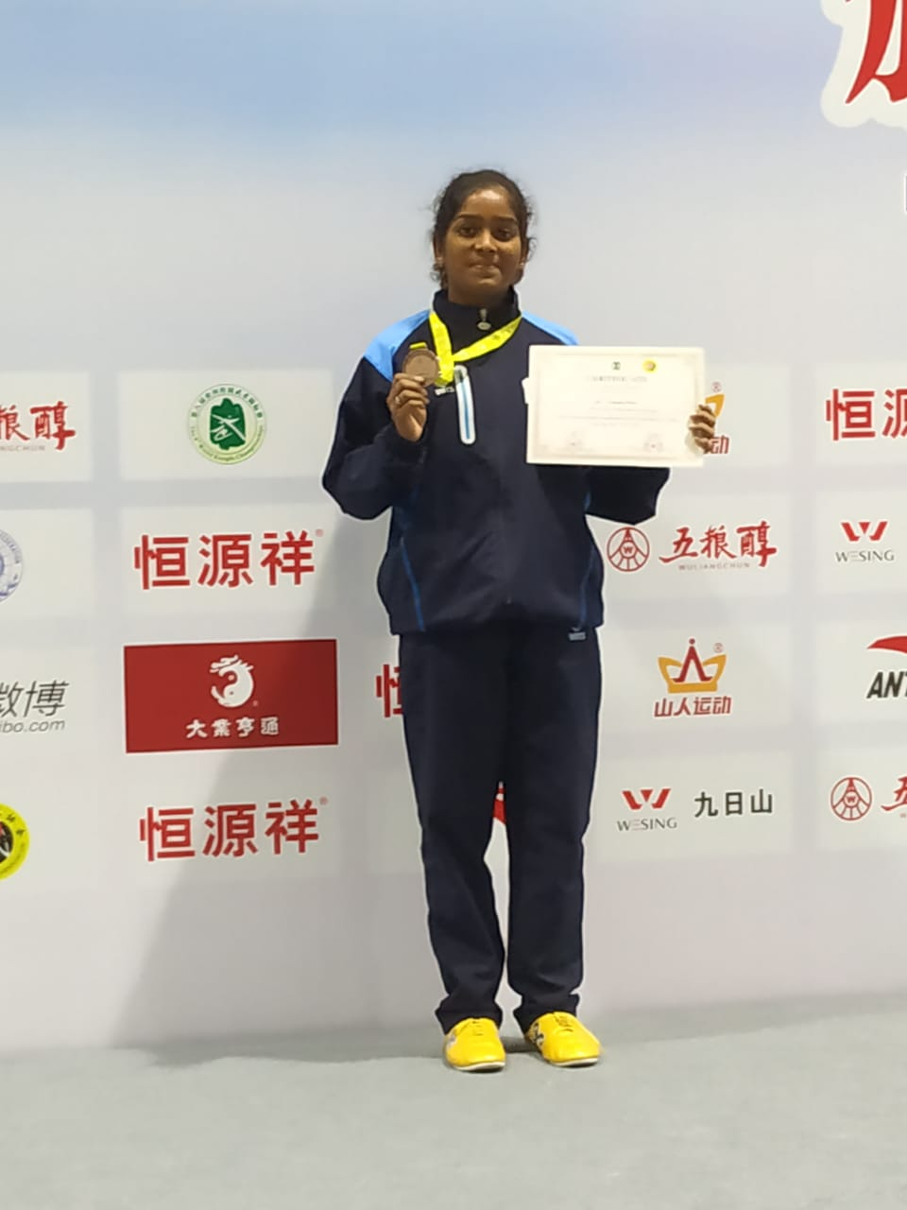
Tamil Nadu WUSHU Achievements in International Championships

Slide 18
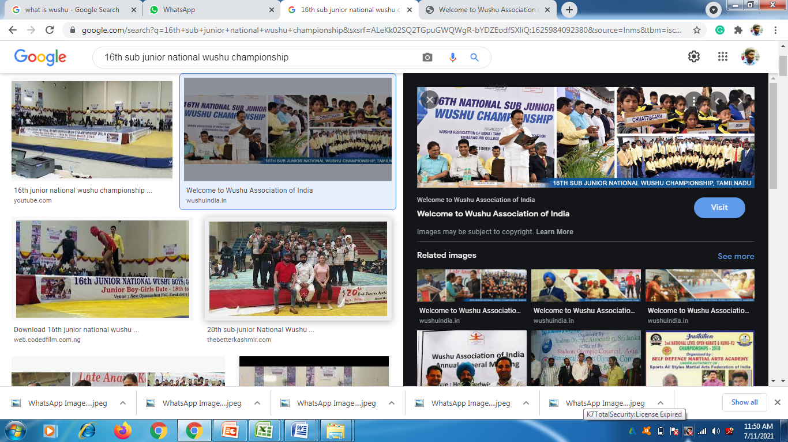
Tamil Nadu WUSHU Achievements in National Championships
16th Sub – Junior National Wushu Championship was hosted by Tamilnadu Wushu Association at Kumaraguru College of Technology, Coimbatore from 8th to 12th October – 2016. Tamil Nadu got 1 Gold, 7 Silver and 7 Bronze Medals and secured overall 3rd place.

Slide 19
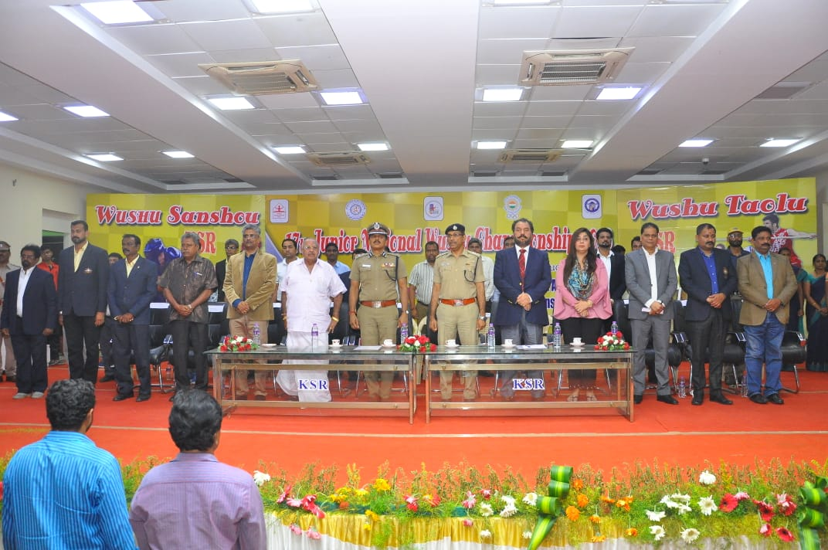
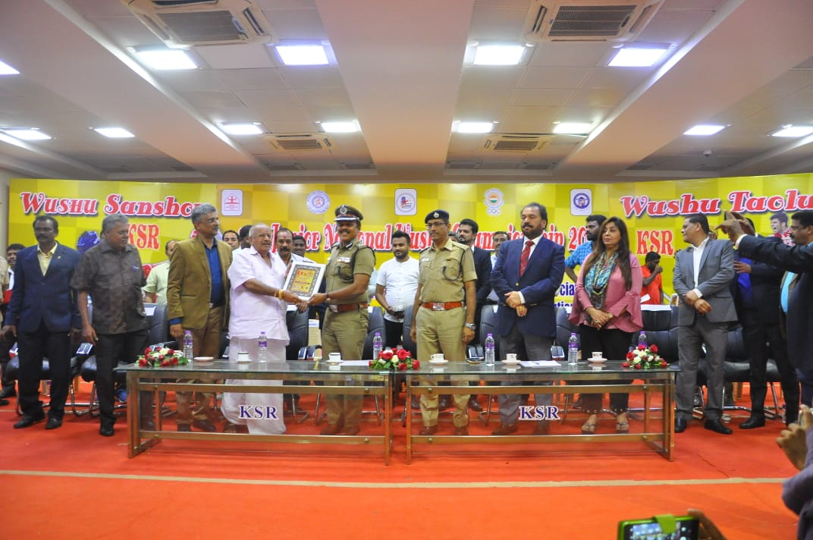
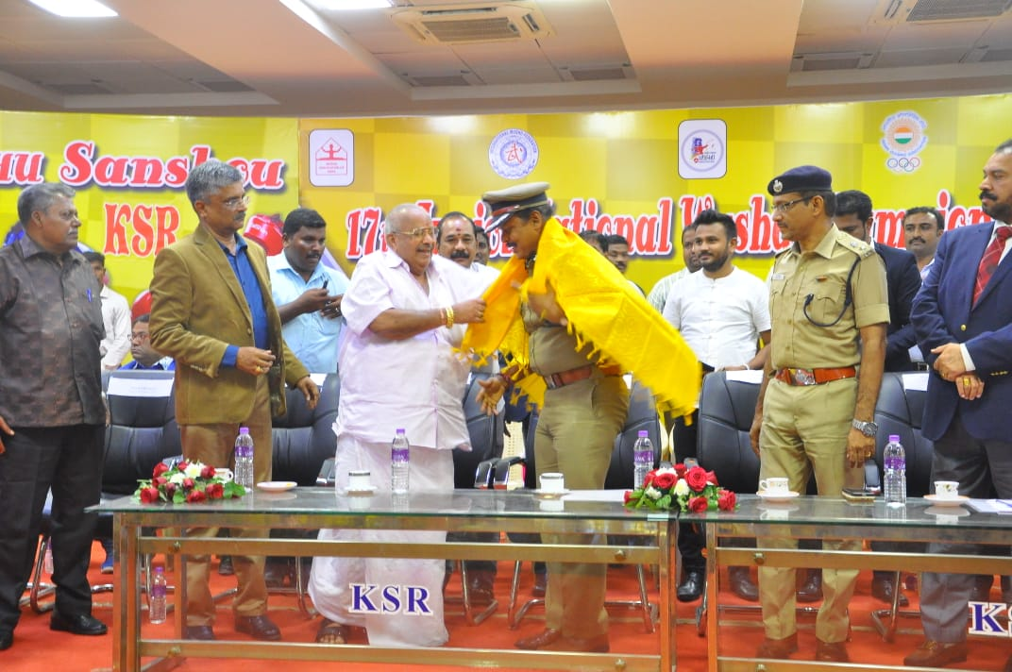
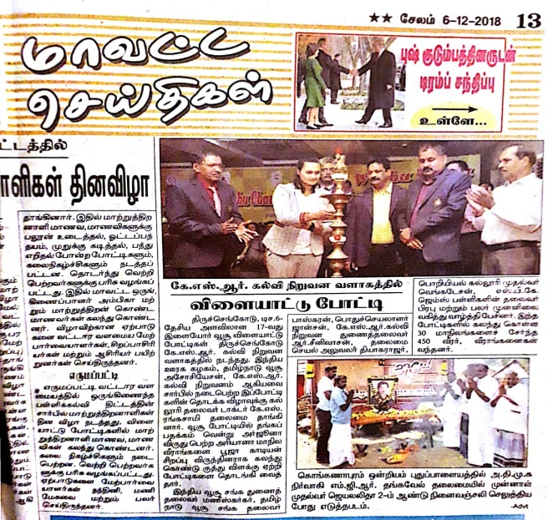
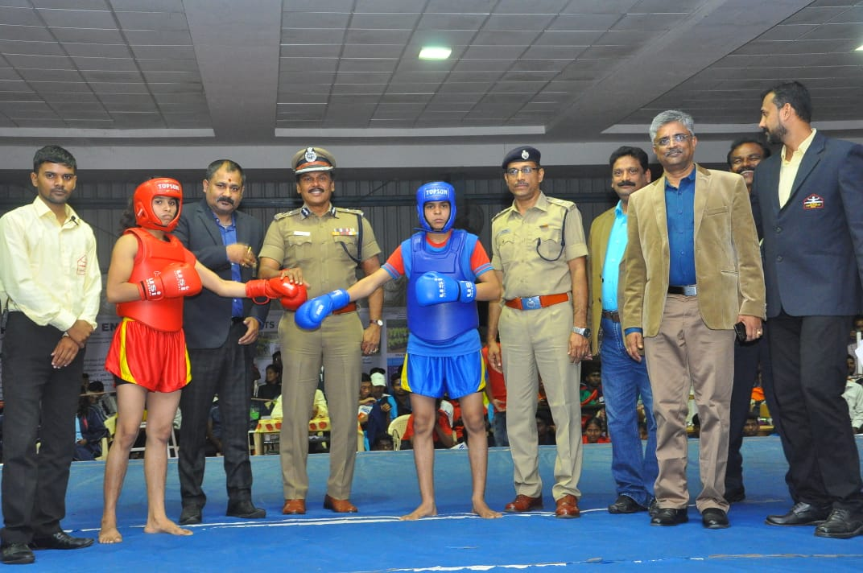
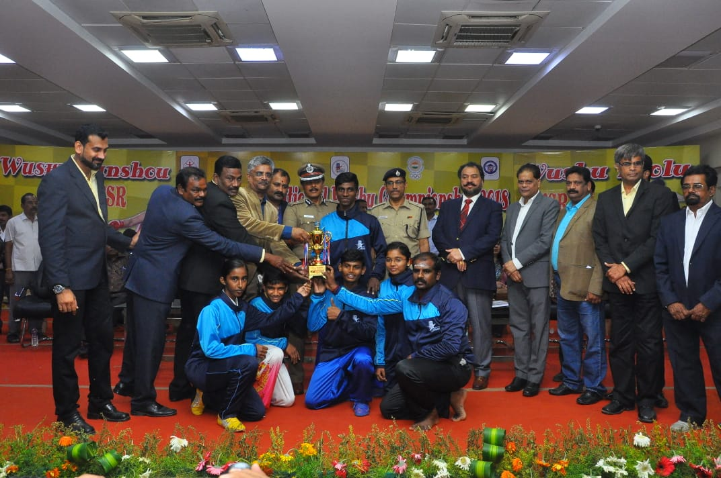
17th Junior National Wushu Championship was hosted by Tamilnadu Wushu Association at KSR College of Engineering, Coimbatore from 1st to 6th December – 2018. In this championship Tamil Nadu got 4 Gold , 4 Silver and 18 Bronze medals and won overall 3rd place.

Slide 20
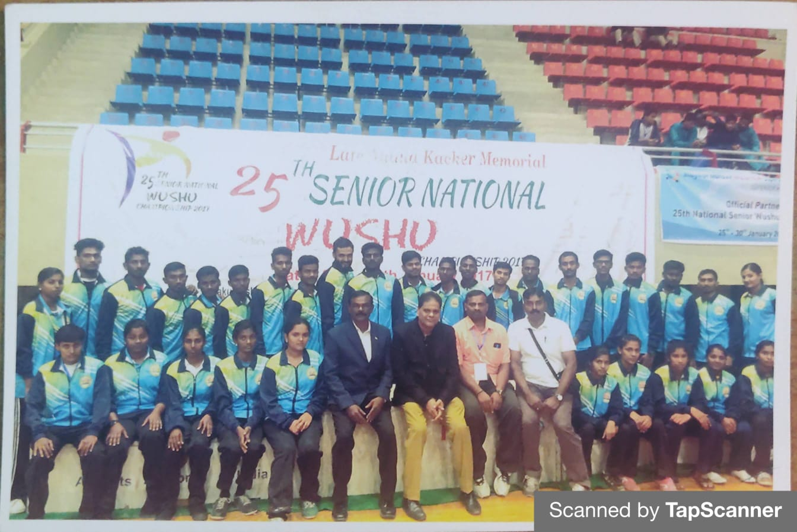
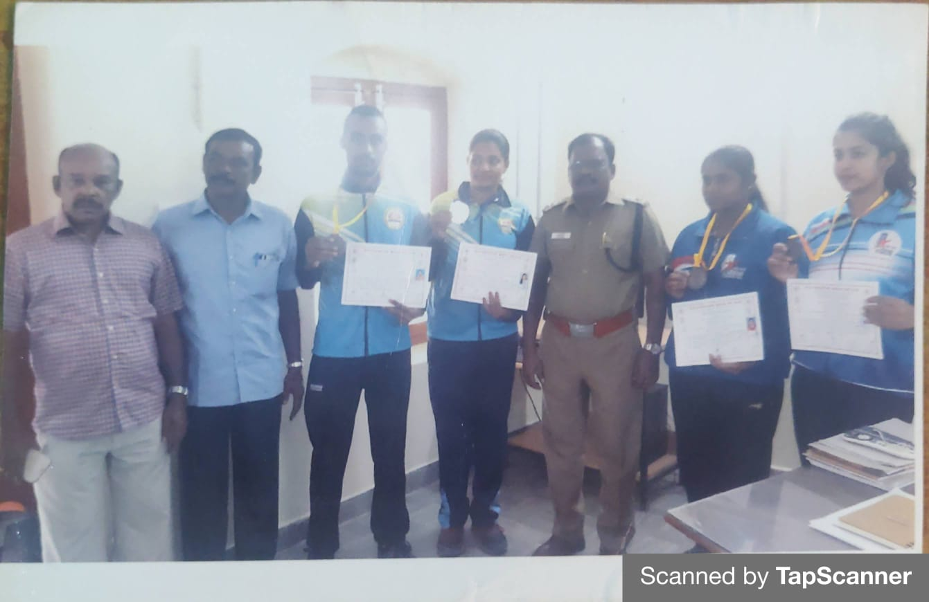
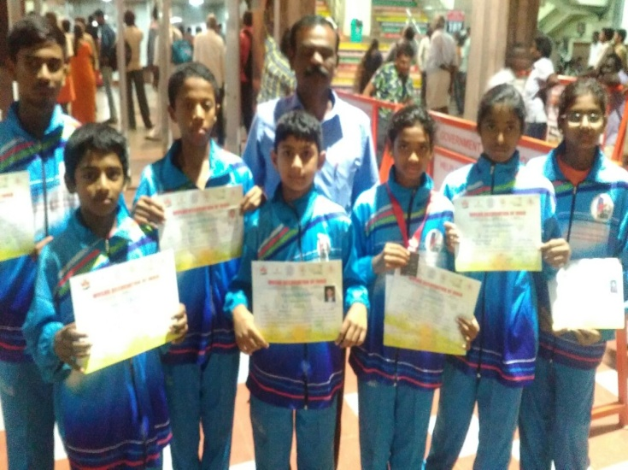
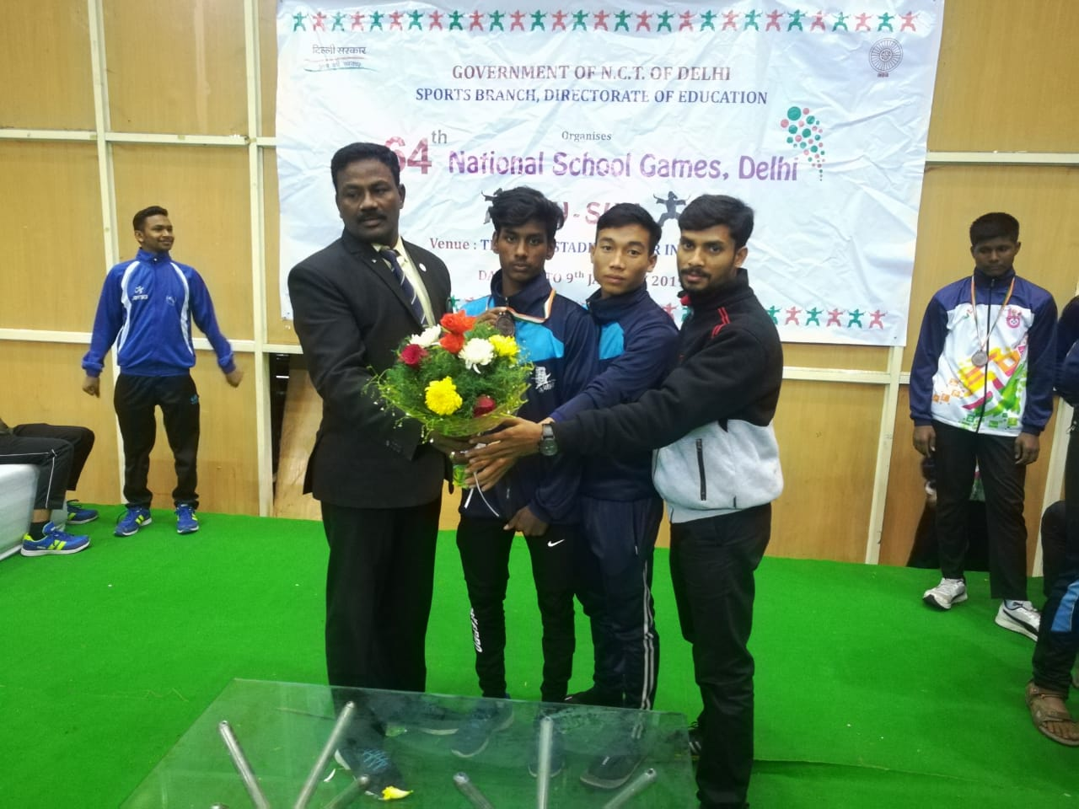
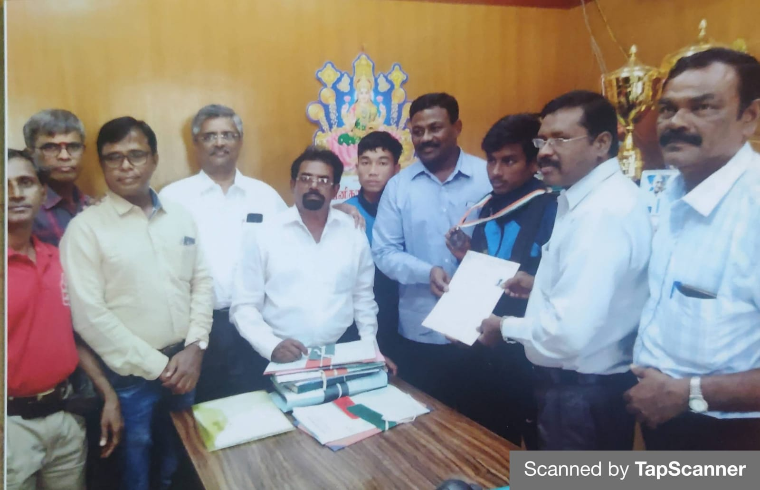
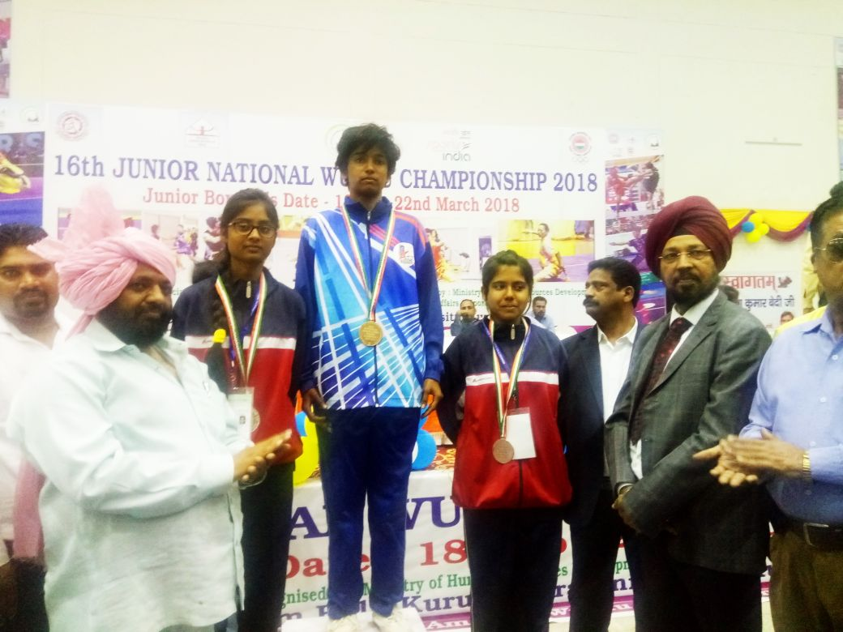
Tamil Nadu WUSHU Achievements in National Championships
25
25th Senior National Wushu Championship 5th Federation Cup 17th Sub – junior National Wushu Championship
64th SGFI Nationals 64th SGFI Nationals 16th Junior National Wushu Championship

Slide 21
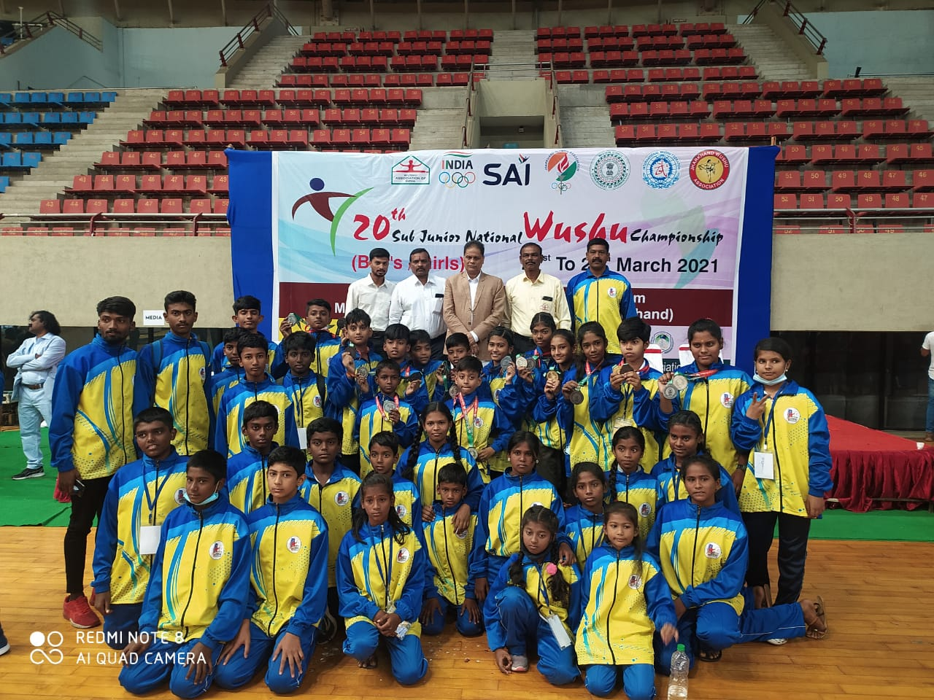
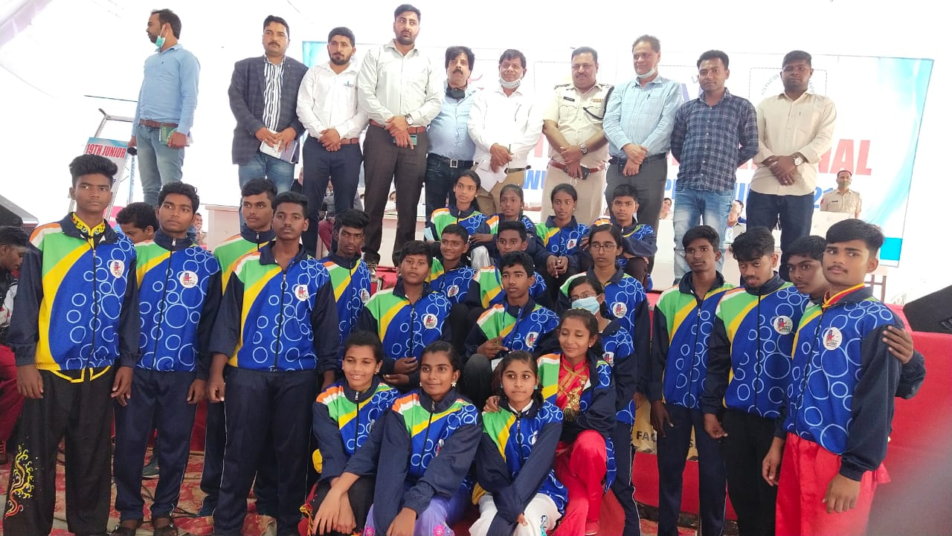
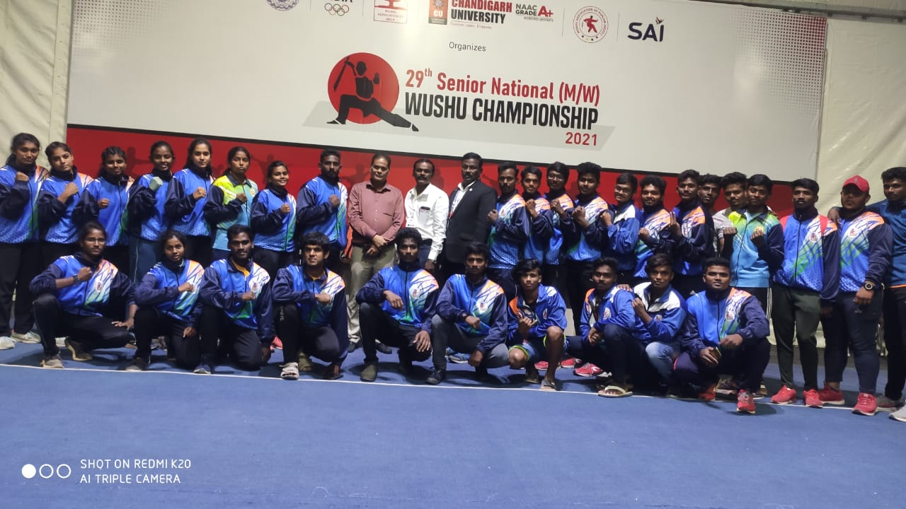



Tamil Nadu WUSHU Achievements in National Championships
20th Sub – Junior National Wushu Championship 18th Junior National Wushu Championship 29th Senior National Wushu Championship
16th Junior National Wushu Championship 58th Inter Zonal Police Meet 26th Senior National Wushu Championship

Slide 22






Tamil Nadu WUSHU Achievements in National Championships
26th Senior National Wushu Championship 17th Sub – Junior National Wushu Championship 18th Sub – Junior National Wushu Championship
65th SGFI National Medal Winners with DPI and SDAT Member Secretary 19th Junior National Wushu Championship

Slide 23





Tamil Nadu WUSHU Achievements in National Championships
All India Inter University Wushu Championship 28th Senior National Wushu Championship

Slide 24



News Paper Cuttings

Slide 25
National Wushu Judges Seminar – 2021 Venue : KPR Institute of Engineering and Technology, Coimbatore Date : 28th August to 2nd September 2021
Wushu Association of India, Tamil Nadu Wushu Association and KPR Institute of Engineering and Technology proudly conducted All India Wushu Training and Selection Seminar from August 28 to September 2 at KPR Institute of Engineering and Technology, Arasur, Coimbatore. About 164 judges from 32 states in India participated in the above seminar.
Chief Guests
Honorable Mr. Kaushal Kishore, Union Minister of State, Ministry of Housing and Urban Development, Government of India.
Dr. K.P. Ramasamy, Chairman, KPR Groups
Mr. S. Selvanagarathinam I.P.S., Superintendent of Police, Coimbatore (Rural).
Dr. M. Akila, Principal, KPR Institute of Engineering and Technology.

Slide 26





National Wushu Judges Seminar – 2021 Venue : KPR Institute of Engineering and Technology, Coimbatore Date : 28th August to 2nd September 2021

Slide 27






Tamil Nadu WUSHU Achievements in National Championships
20th Junior National Wushu Championship. We Got 2 Gold Medals, 3 Silver medals and 16 Bronze Medals in this championship. And for the first time we got 4th position in overall.
30th Senior National Wushu Championship. In this championship we got 4 Silver Medals and 2 Bronze Medals.
All India Inter University Wushu Championship 2022. Won 3 Gold Medals, 5 Silver Medals and 5 Bronze Medals.

Slide 28
21th Sub – Junior National Wushu Championship (Boys & Girls) Venue : Noorul Islam University, Nagercoil, Kanyakumari. Date : 25th to 31st March 2022.
Wushu Association of India, Tamil Nadu Wushu Association and Noorul Islam Center for Higher Education jointly conducted 21st Sub – Junior National Wushu Championship was held at Noorul Islam University, Nagercoil, Kanyakumari District from March 25 to 31. About 1100 athletes from 32 states in India participated in the above tournament. In this, Tamil Nadu won 4 gold, 18 silver and 23 bronze medals for a total of 45 medals and became the 2nd place in Taolu overall.
This mega event’s Welcome Addressed by Mr. P. Johnson General Secretary, Tamil Nadu Wushu Association.
Presided By
Honorable Thiru. M. Appavu, Speaker of Tamil Nadu Legislative Assembly.
Chief Guests
Honorable Thiru. T. Mano Thangaraj, Minister of Information Technology of TN
Thiru. Dr. A.P. Majeed Khan, Founder and Chancellor of NICHE
Thiru. V. Balakrishnan, I.P.S., Inspector General of Police, Central Zone, TN
Mr. Bhupender Singh Bajwa, President, Wushu Association of India
Mr. Jatinder Singh Bajwa, General Secretary, Wushu Association of India
Mr. Suhel Ahmed, CEO, Wushu Association of India
Felicitation
Mr. A. Alex, President, Organizing Committee
Mr. V. Badri Narayanan, I.P.S., Superintendent of Police, Kanyakumar
Mr. J.M. Fernando, CAO, Tamil Nadu Olympic Association
Mr. J. David Daniel, District Sports and Youth Welfare Officer, Kanyakumar
Mr. R. Venkatesh, B.Sc., B.L., Advocate, Chennai High Court

Slide 29





21th Sub – Junior National Wushu Championship (Boys & Girls) Venue : Noorul Islam University, Nagercoil, Kanyakumari. Date : 25th to 31st March 2022.

Slide 30

Tamil Nadu WUSHU Achievements in National Championships

